Slide 1

Problem Statement
The COVID-19 outbreak may increase, and so the hospitals may anytime be fully occupied. The sudden increase in the patient population may cause a plethora of problems to hospital management. The problem statement here is to predict the number of patients who may be admitted to the hospital in the future. Moreover, this helps hospital management to be ready for admitting any number of patients with ease.

Slide 2
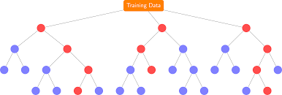
Plan of Action
In order to predict future COVID-19 cases, machine learning algorithms should be used. Also, the Random Forest algorithm will be the best match for predicting future patients getting into hospitals. As the dataset is a bit big, the SPARK language is used for implementing this machine learning algorithm.

Slide 3
About the Dataset
The dataset has Toronto's COVID-19 outbreak data, and it has around 170000 rows and 18 columns, and they are as follow, Currently Intubated, Source of Infection, Ever Hospitalized, Ever in ICU, Age Group, Client Gender, Ever Intubated, Currently Hospitalized, Currently in ICU, Id, Assigned Id, Neighborhood Name, FSA, Classification, Reported Date, Episode Date, Classification and Outbreak Associated.
REFERENCE:
https://open.toronto.ca/dataset/covid-19-cases-in-toronto/

Slide 4

Data cleaning
The data cleaning part was done with Microsoft Excel, and the string values are replaced with integer values i.e. 1 and 0 for implementing the Random Forest algorithm for predicting the number of patients who may be admitted to the hospital in the future in Toronto.
VLOOKUP TABLES and IF STATEMENTS are used for replacing strings to 1’s and 0’s.
EXAMPLE:
1. =IF(M2=“YES”,1,0)
2. =VLOOKUP(D2,$S$2:$T$10,2,FALSE)

Slide 5
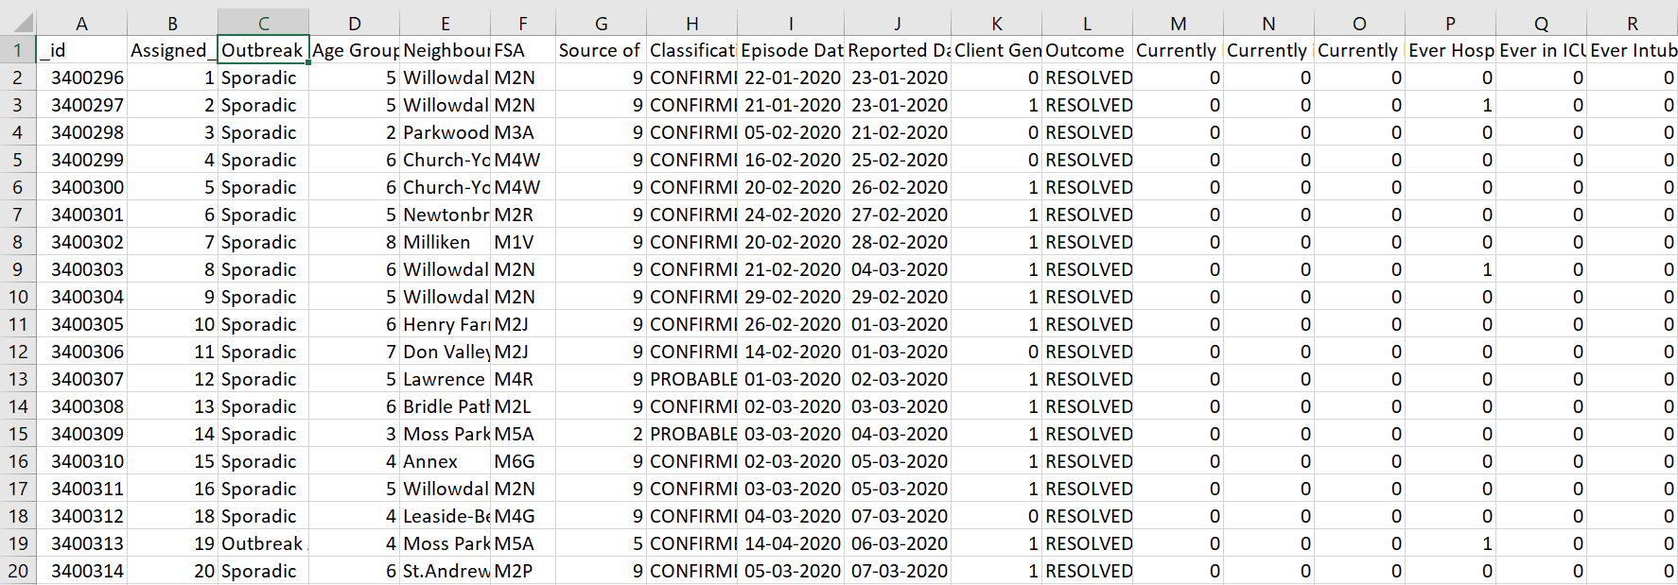
The first 20 rows and all columns of the dataset

Slide 6

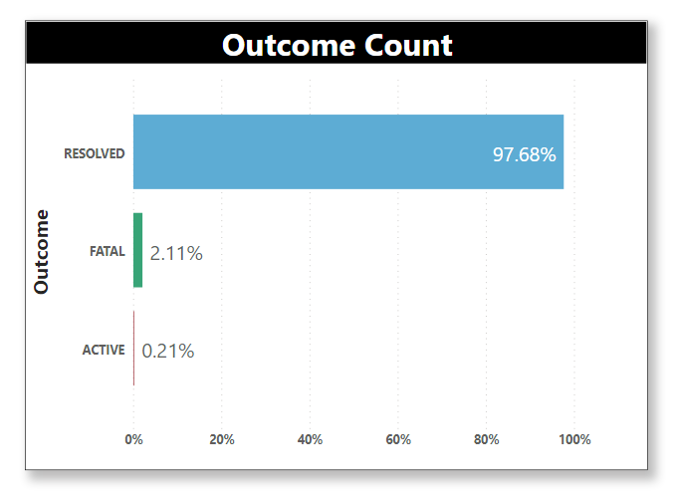
Data Analysis
The dataset has around 98% as a resolved outcome, around 2% as a fatal outcome, and less than 1% as an active outcome. The Random Forest algorithm will mostly predict the outcome as resolved because of its higher percentage in the dataset, and so balancing is done on the dataset using SPARK.

Slide 7
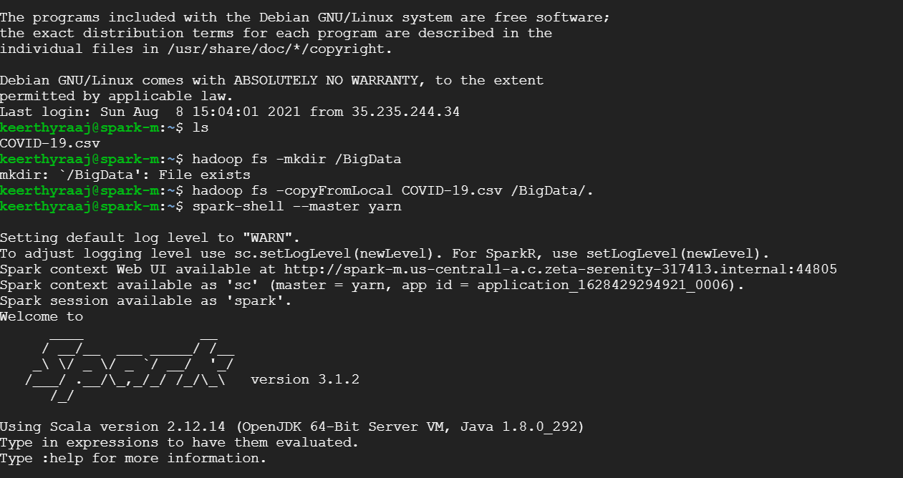
Spark Code for Balancing and Implementing Random Forest Algorithm

Slide 8
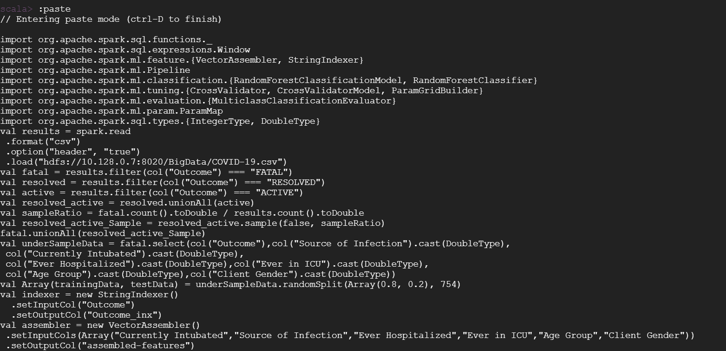

Slide 9
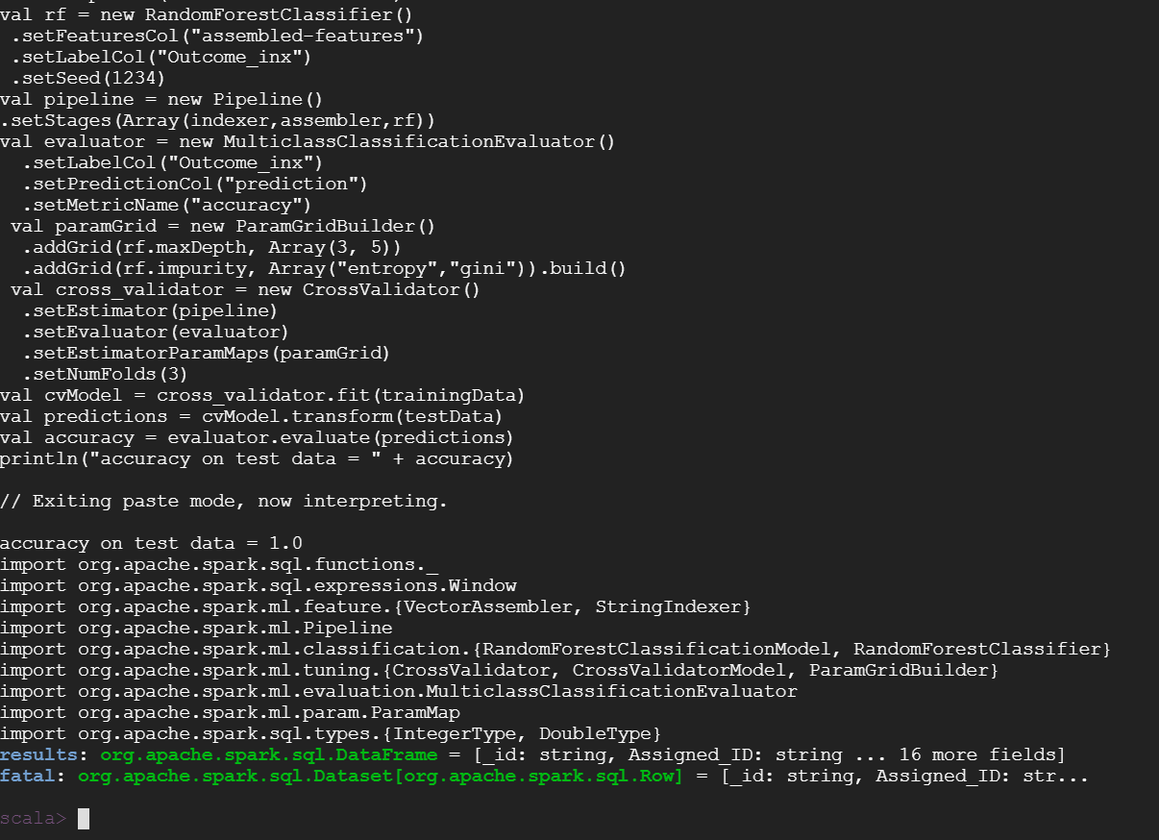

Slide 10
REFERENCE
http://blog.madhukaraphatak.com/class-imbalance-part-3/

